Slide 1

PHY109: ENGINEERING PHYSICS Unit IV: Quantum Mechanics Dr. Jeeban Pd Gewali Department of Physics Lovely Professional University

Slide 2
“The discovery of quantum mechanics was nearly a total surprise. It described the physical world in a way that was fundamentally new. It seemed to many of us a miracle.”
Eugene Wigner
Notes:
The fundamental difference between classical (or Newtonian) mechanics and quantum mechanics lies in what they describe. In classical mechanics, the future history of a particle is completely determined by its initial position and momentum together with the forces that act upon it. In the everyday world these quantities can all be determined well enough for the predictions of Newtonian mechanics to agree with what we find.
Quantum mechanics also arrives at relationships between observable quantities, but the uncertainty principle suggests that the nature of an observable quantity is different in the atomic realm. Cause and effect are still related in quantum mechanics, but what they concern needs careful interpretation. In quantum mechanics the kind of certainty about the future characteristic of classical mechanics is impossible because the initial state of a particle cannot be established with sufficient accuracy. As we saw in Sec. 3.7, the more we know about the position of a particle now, the less we know about its momentum and hence about its position later.
The quantities whose relationships quantum mechanics explores are probabilities. Instead of asserting, for example, that the radius of the electron’s orbit in a groundstate hydrogen atom is always exactly 5.3 1011 m, as the Bohr theory does, quantum mechanics states that this is the most probable radius. In a suitable experiment most trials will yield a different value, either larger or smaller, but the value most likely to be found will be 0.53 angstrom.

Slide 3
Content
Introduction
Particle Nature of light
Photoelectric effect
Wave nature of light
de Broglie matter waves, Phase velocity, Group velocity
Heisenberg uncertainty principle
Wave function and its significance
Schrodinger equation: time dependent and time independent
Particle in one dimensional box

Slide 4
Introduction
At the end of the nineteenth century, physics consisted essentially of classical mechanics, the theory of electromagnetism, and thermodynamics.
Classical mechanics: describes the dynamics of material bodies.
Electromagnetism: study of electricity, magnetism and optics
Thermodynamics: explains the interactions between matter and radiation.
In the beginning of the twentieth century, classical physics was seriously challenged by two major domains:
Relativistic domain: Einstein’s theory of relativity (1905) showed that the validity of Newtonian mechanics fails at speeds comparable to that of light (c = 3×10⁸ m/s).
Microscopic domain: Classical physics fails to explain several phenomena: blackbody radiation, the photoelectric effect, atomic stability, and atomic spectroscopy.
seemed that all known physical phenomena could be explained !
Notes:
The overwhelming success of classical physics—classical mechanics, classical theory of electromagnetism, and thermodynamics—made people believe that the ultimate description of nature had been achieved. It seemed that all known physical phenomena could be explained within the framework of the general theories of matter and radiation.

Slide 5
Timeline
Particle aspect of waves; that is, the concept that waves exhibit particle behavior at the microscopic scale. At this scale, classical physics fails not only quantitatively but even qualitatively and conceptually.
1900: Max Planck introduced the concept of the quantum of energy (energy exchange between an electromagnetic wave of frequency and matter occurs only in integer multiples of hv) and explained the phenomenon of blackbody radiation.
1905: Einstein explained the photoelectric effect using the concept of photon (light itself is made of discrete bits of energy or tiny particles), which was unsolved since its first experimental observation by Hertz in 1887.
1913: Neil Bohr introduced a model of Hydrogen atom: atoms can be found only in discrete states of energy and the emission or absorption of radiation by atoms takes place only in discrete energy states. This work provided a satisfactory explanation to several outstanding problems such as atomic stability and atomic spectroscopy.
1923: Compton demonstrated corpuscular aspect of light. By scattering X-rays with electrons, he confirmed that the X-ray photons behave like particles.
Notes:
. He argued that the, where h is a fundamental constant called Planck’s constant. The quantization of electromagnetic radiation turned out to be an idea with far-reaching consequences. Planck’s idea, which gave an accurate explanation of blackbody radiation, prompted new thinking and triggered an avalanche of new discoveries that yielded solutions to the most outstanding problems of the time.
Right after Rutherford’s experimental discovery of the atomic nucleus in 1911, and combining Rutherford’s atomic model, Planck’s quantum concept, and Einstein’s photons, atoms can be found only in discrete states of energy and that the interaction of atoms with radiation, i.e., the emission or absorption of radiation by atoms, takes place only in discrete amounts of h􀁆 because it results from transitions of the atom between its various discrete energy states. This work provided a satisfactory explanation to several outstanding problems such as atomic stability and atomic spectroscopy.

Slide 6
Wave aspect of light; that is, the concept that waves exhibit particle behavior at the microscopic scale. At this scale, classical physics fails not only quantitatively but even qualitatively and conceptually.
1923: de Broglie postulated that material particles exhibits wave behavior.
1927: Davisson and Germer confirmed de Broglie postulate by showing interference patterns (a property of waves) of electrons (matter).
1925: Heisenberg formulated matrix mechanics to describe atomic structure; expressing dynamical quantities such as energy, position, momentum and angular momentum in terms of matrices, he obtained an eigenvalue problem that describes the dynamics of microscopic systems: foundation of quantum mechanics.
1926: Schrödinger describes the dynamics of microscopic matter by means of a wave mechanics: a generalization of the de Broglie postulate, called the Schrödinger equation. Schrödinger obtained a differential equation: foundation of quantum mechanics.
1927: Max Born proposed his probabilistic interpretation of wave mechanics: he took the square moduli of the wave functions that are solutions to the Schrödinger equation and he interpreted them as probability densities.
Dirac suggested a more general formulation of quantum mechanics which deals with abstract objects such as kets (state vectors), bras, and operators: foundation of quantum mechanics.
Notes:
In addition to providing an accurate reproduction of the existing experimental data, this theory turned out to possess an astonishingly reliable prediction power which enabled it to explore and unravel many uncharted areas of the microphysical world. This new theory had put an end to twenty five years (1900–1925) of patchwork which was dominated by the ideas of Planck and Bohr and which later became known as the old quantum theory.
This new theory had put an end to twenty five years (1900–1925) of patchwork which was dominated by the ideas of Planck and Bohr and which later became known as the old quantum theory.

Slide 7
Photoelectric effect particle nature of light
E_{vac}
E_{vac}
E_{c}
W
E_{F}
W
E_{F}
E_{v}
Band diagram for
metal
Band diagram for
semiconductor
Metal | Cs | Li | Ca | Cu | Ag | Pt
Work function (eV) | 1.9 | 2.3 | 3.2 | 4.7 | 4.7 | 6.4
work function (W) = hv₀ = E_{vac} - E_{F}

Slide 8

Photon characteristics
Photon: a quantum of electromagnetic radiation.
Energy
$$E=hν$$
$$E=hc/λ$$
$$E(eV)=1240/λ(nm)$$
Momentum
$$p=E/c$$
$$p=hν/c$$
Rest mass (m₀)= zero.

Slide 9
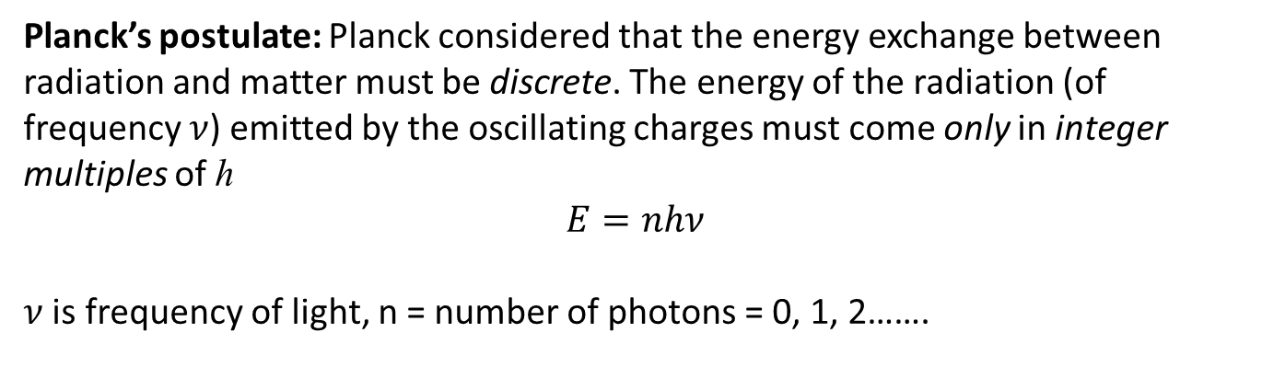
Particle Nature of light
Particle: a localized object carries volume, density, mass, momentum, energy etc.
Photoelectric effect: When light of energy greater than work function of a metal incident of the metal surface, the electrons (photoelectron) are ejected from the metal surface.
The photoelectric effect provides a direct confirmation for the energy quantization of light.
1887: Hertz discovered the photoelectric effect: electrons were observed to be ejected from metals when irradiated with light.
In 1905, Einstein explained the photoelectric effect using Planck’s quantization rule.
Planck’s postulate: Planck considered that the energy exchange between radiation and matter must be discrete. The energy of the radiation (of frequency $ν$) emitted by the oscillating charges must come only in integer multiples of h
$$E=nhν$$
$ν$ is frequency of light, n = number of photons = 0, 1, 2…….
Photoelectric effect

Slide 10
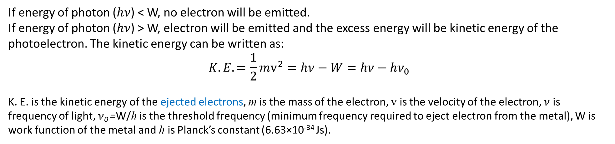

Work function: Energy required to remove electron from a metal surface.
It is energy difference of vacuum level and Fermi level.
If energy of photon ($hν$) < W, no electron will be emitted.
If energy of photon ($hν$) > W, electron will be emitted and the excess energy will be kinetic energy of the photoelectron. The kinetic energy can be written as:
$$K.E.=\frac{1}{2}mv^{2}=hν−W=hν−hν_{0}$$
K. E. is the kinetic energy of the ejected electrons, m is the mass of the electron, v is the velocity of the electron, $ν$ is frequency of light, $ν$₀ =W/his the threshold frequency (minimum frequency required to eject electron from the metal), W is work function of the metal and h is Planck’s constant (6.63×10⁻³⁴ Js).
Stopping potential (V_{S}): at which all of the electrons will be turned back before reaching the collector (anode); hence the flow of photoelectric current ceases completely at V_{S}.
$$eV_{s}=K.E.=hν−W$$
Experimental setup of photoelectric effect

Slide 11
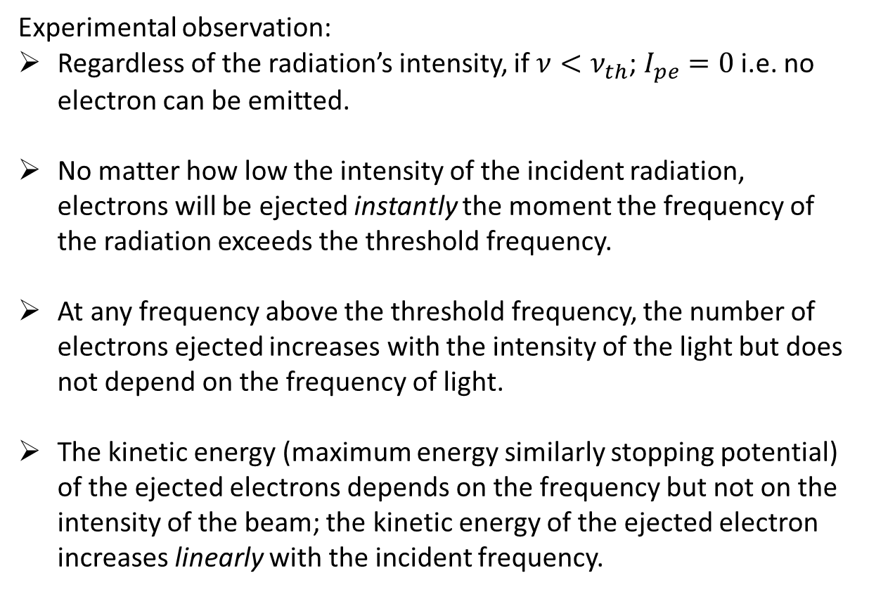
Experimental observation:
Regardless of the radiation’s intensity, if $ν<ν_{th}$; $I_{pe}=0$ i.e. no electron can be emitted.
No matter how low the intensity of the incident radiation, electrons will be ejected instantly the moment the frequency of the radiation exceeds the threshold frequency.
At any frequency above the threshold frequency, the number of electrons ejected increases with the intensity of the light but does not depend on the frequency of light.
The kinetic energy (maximum energy similarly stopping potential) of the ejected electrons depends on the frequency but not on the intensity of the beam; the kinetic energy of the ejected electron increases linearly with the incident frequency.
Thus, the photoelectric effect provides an evidence for the corpuscular (particle) nature of the light (electromagnetic radiation).

Slide 12



Practice problems
The unit of Planck’s constant is
J/s
Js
s/J
Hz
Which of the following is a characteristics of the photon
$m_{0}=0$
$E=hν$
$p=\frac{hν}{c}$

Slide 13


Which of the following gives the unit of momentum
$ℏk$
$h/λ$
Both of these
None of these
Which of the following phenomena does not explain the particle aspect of light
Photoelectric effect
Compton Effect
Scattering
Interference

Slide 14
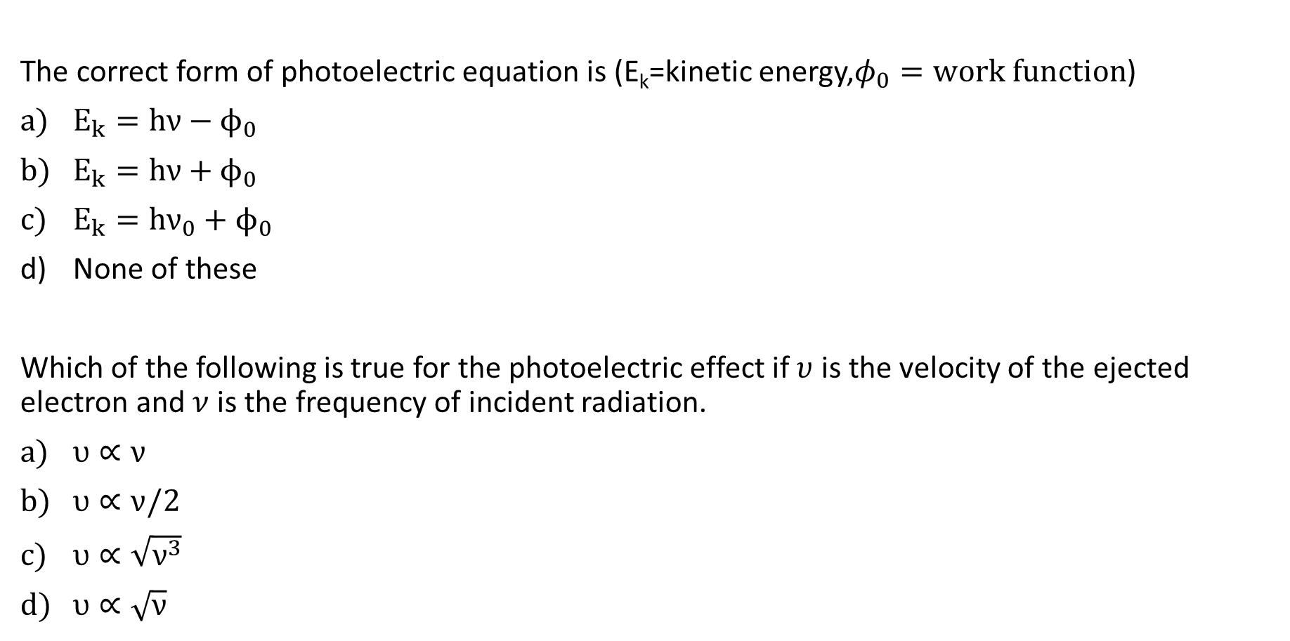

The correct form of photoelectric equation is (E_{k}=kinetic energy,$φ_{0}=work function$)
$E_{k}=hν−ϕ_{0}$
$E_{k}=hν+ϕ_{0}$
$E_{k}=hν_{0}+ϕ_{0}$
None of these
Which of the following is true for the photoelectric effect if $υ$ is the velocity of the ejected electron and $ν$ is the frequency of incident radiation.
$υ∝ν$
$υ∝ν/2$
$υ∝\sqrt{ν^{3}}$
$υ∝\sqrt{ν}$

Slide 15
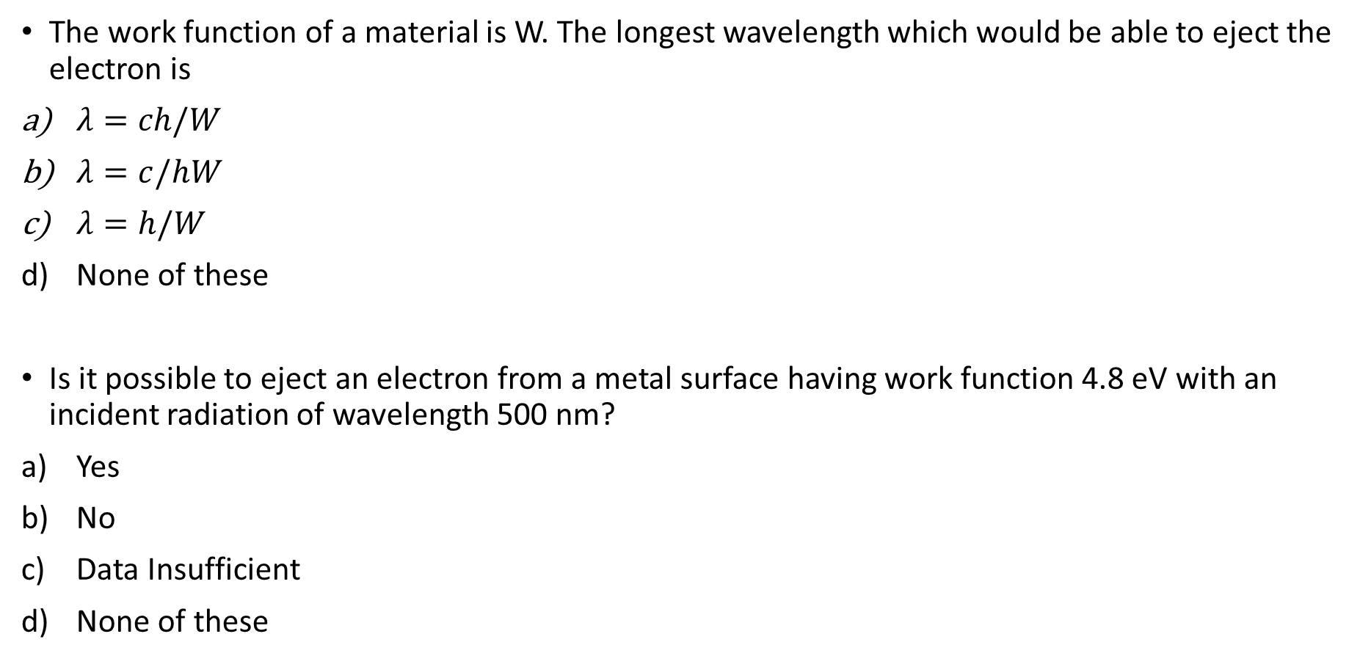
The work function of a material is W. The longest wavelength which would be able to eject the electron is
$λ=ch/W$
$λ=c/hW$
$λ=h/W$
None of these
Is it possible to eject an electron from a metal surface having work function 4.8 eV with an incident radiation of wavelength 500 nm?
Yes
No
Data Insufficient
None of these

Slide 16
The work function of sodium metal is 2.3 eV. What is the closest value of the longest wavelength of light that can cause the photoelectric emission from the sodium?
539.7 nm
402.1 nm
513.6 nm
None of these

Slide 17
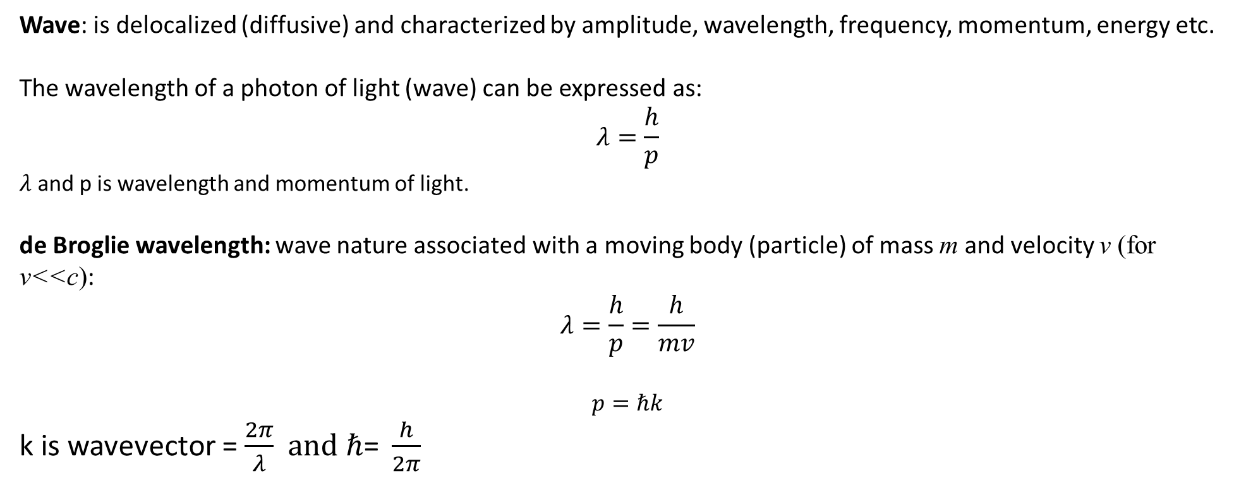
Wave Nature of particle
Wave: is delocalized (diffusive) and characterized by amplitude, wavelength, frequency, momentum, energy etc.
The wavelength of a photon of light (wave) can be expressed as:
$$λ=\frac{h}{p}$$
$λ$ and p is wavelength and momentum of light.
de Broglie wavelength: wave nature associated with a moving body (particle) of mass m and velocity v (for v<<c):
$$λ=\frac{h}{p}=\frac{h}{mv}$$
$$p=ℏk$$
k is wavevector = $\frac{2π}{λ} and ℏ\text{= }\frac{h}{2π}$

Slide 18
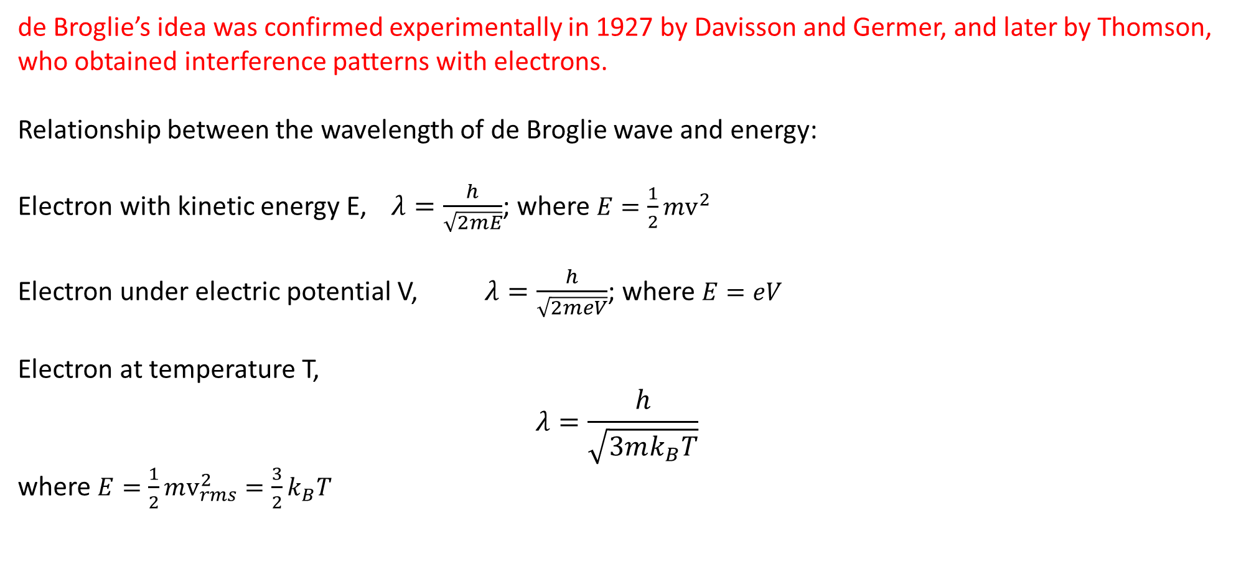
de Broglie’s idea was confirmed experimentally in 1927 by Davisson and Germer, and later by Thomson, who obtained interference patterns with electrons.
Relationship between the wavelength of de Broglie wave and energy:
Electron with kinetic energy E, $λ=\frac{h}{\sqrt{2mE}}$; where $E=\frac{1}{2}mv^{2}$
Electron under electric potential V, $λ=\frac{h}{\sqrt{2meV}}$; where $E=eV$
Electron at temperature T,
$$λ=\frac{h}{\sqrt{3mk_{B}T}}$$
where $E=\frac{1}{2}mv_{rms}^{2}=\frac{3}{2}k_{B}T$

Slide 19
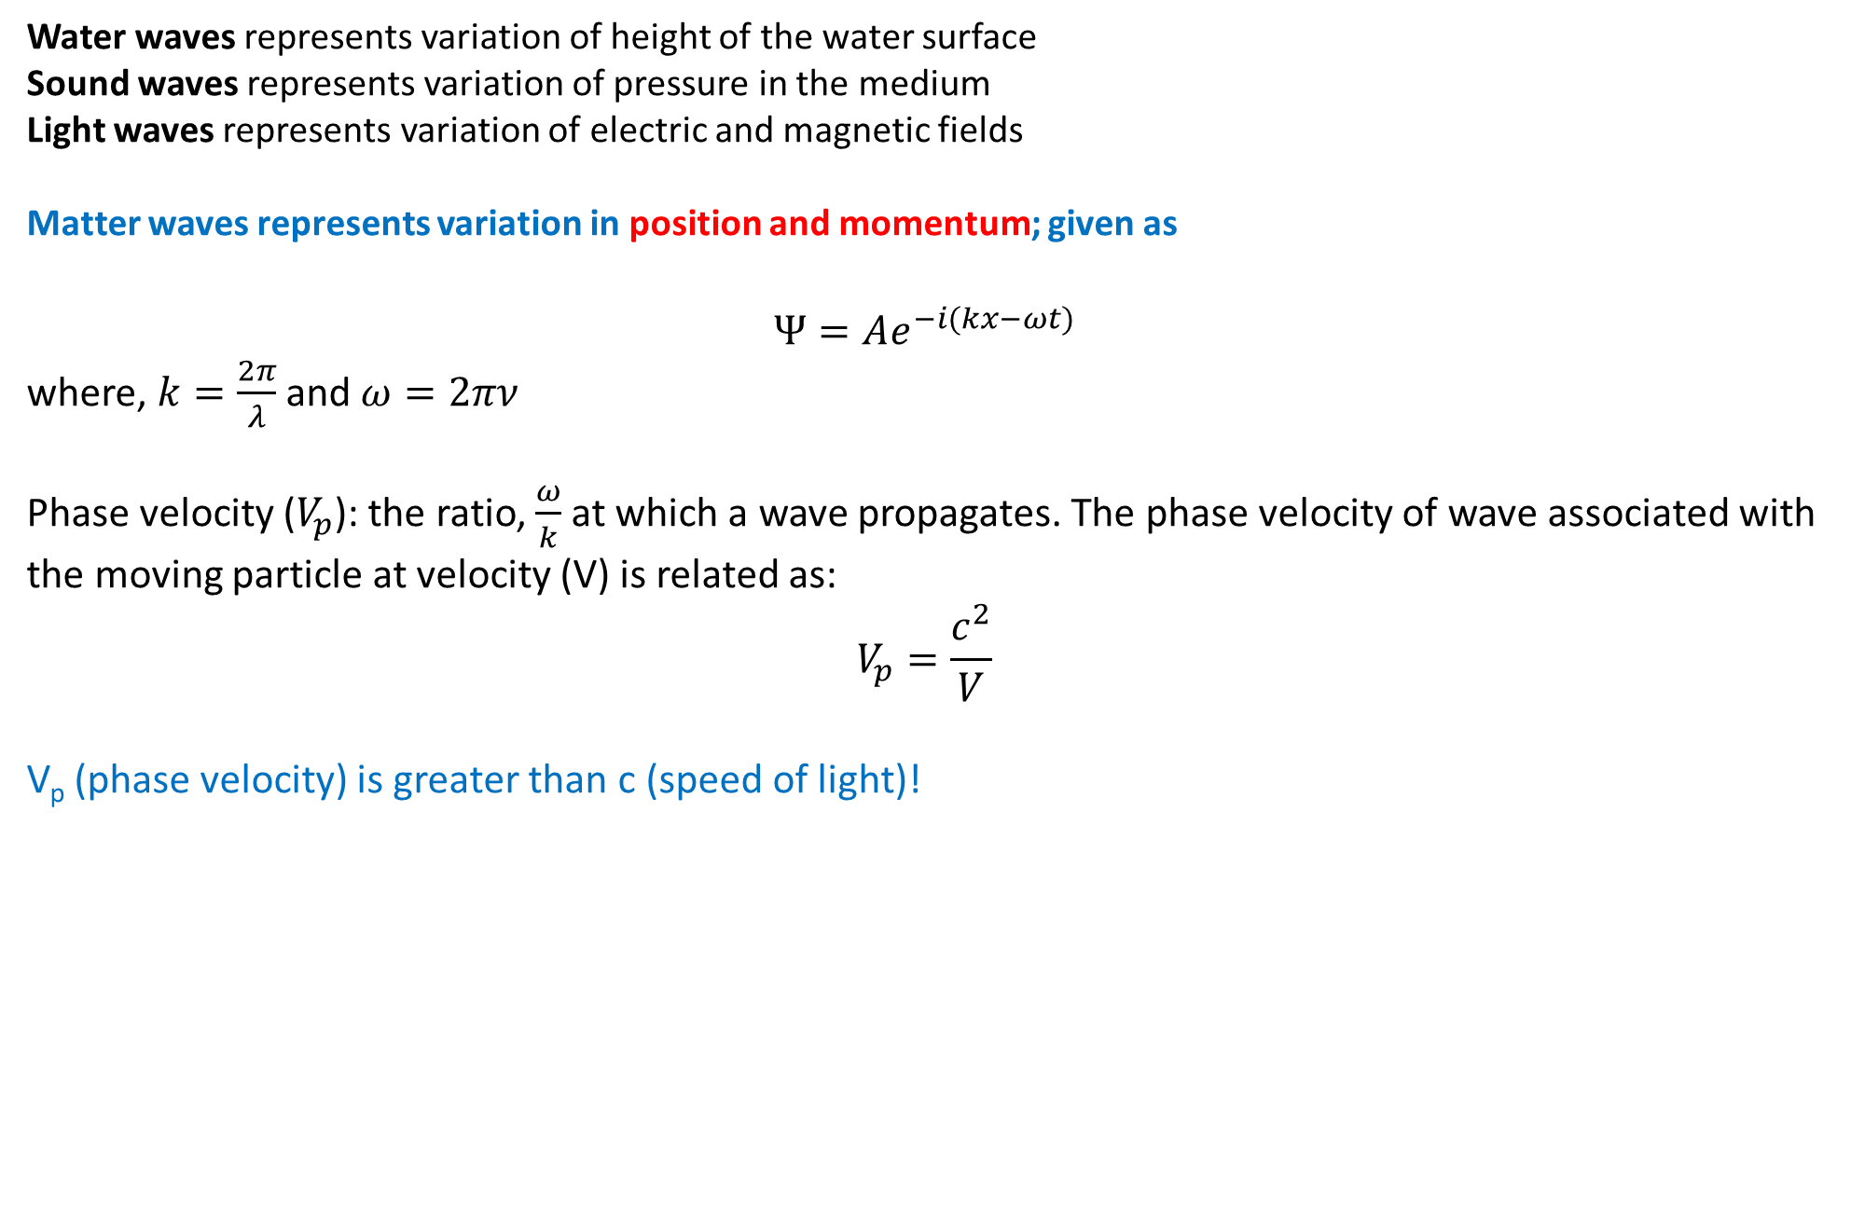
de Broglie waves (matter waves)
Water waves representsvariation of height of the water surface
Sound waves represents variation of pressure in the medium
Light waves represents variation of electric and magnetic fields
Matter waves represents variation in position and momentum; given as
$$Ψ=Ae^{−i(kx−ωt)}$$
where, $k=\frac{2π}{λ}$ and $ω=2πν$
Phase velocity ($V_{p}$): the ratio, $\frac{ω}{k}$at which a wave propagates. The phase velocity of wave associated with the moving particle at velocity (V) is related as:
$$V_{p}=\frac{c^{2}}{V}$$
V_{p} (phase velocity) is greater than c (speed of light)!

Slide 20
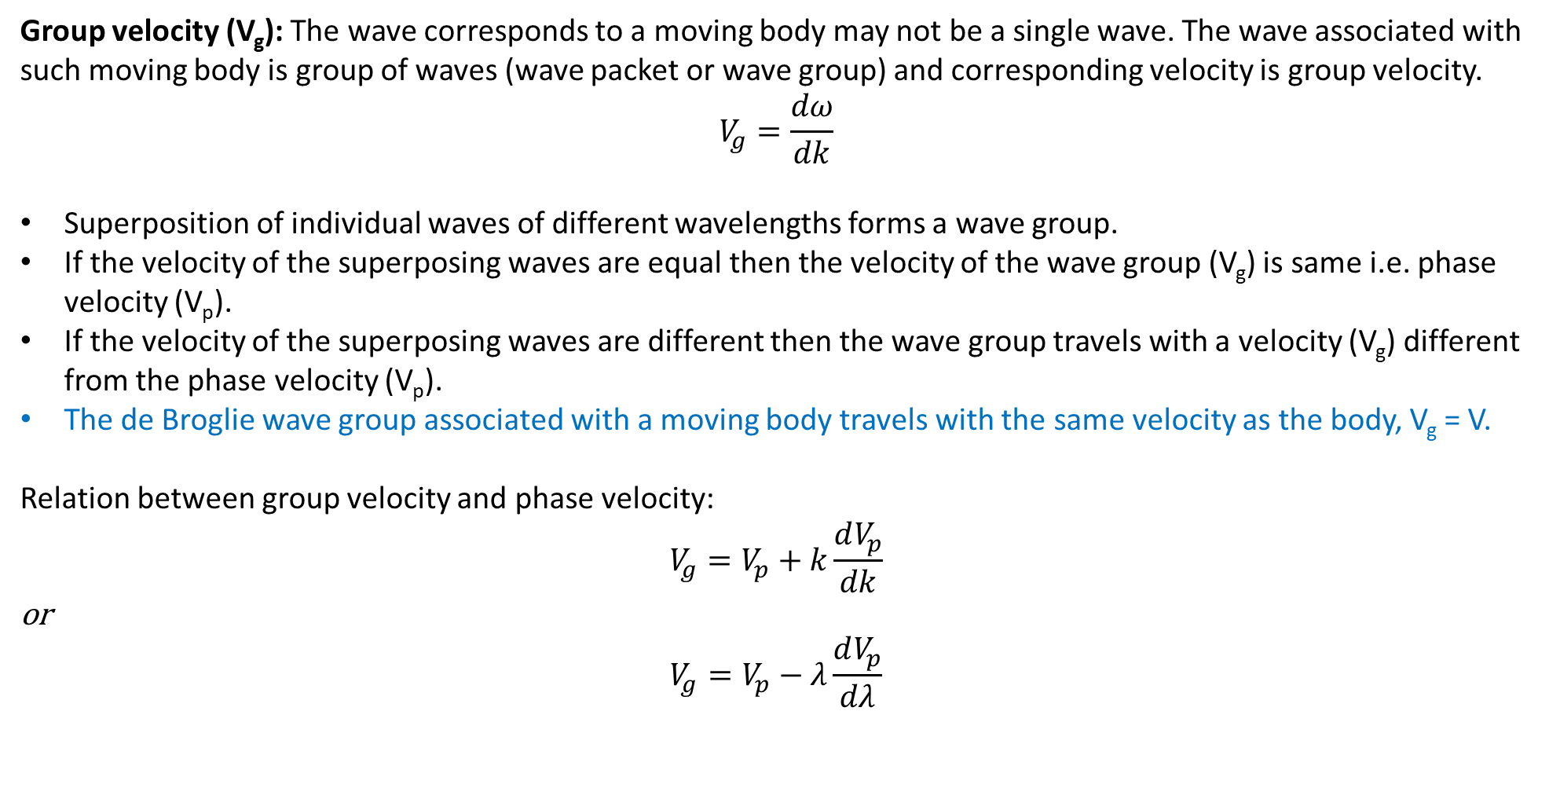
Group velocity (V_{g}): The wave corresponds to a moving body may not be a single wave. The wave associated with such moving body is group of waves (wave packet or wave group) and corresponding velocity is group velocity.
$$V_{g}=\frac{dω}{dk}$$
Superposition of individual waves of different wavelengths forms a wave group.
If the velocity of the superposing waves are equal then the velocity of the wave group (V_{g}) is same i.e. phase velocity (V_{p}).
If the velocity of the superposing waves are different then the wave group travels with a velocity (V_{g}) different from the phase velocity (V_{p}).
The de Broglie wave group associated with a moving body travels with the same velocity as the body, V_{g} = V.
Relation between group velocity and phase velocity:
$$V_{g}=V_{p}+k\frac{dV_{p}}{dk}$$
or
$$V_{g}=V_{p}−λ\frac{dV_{p}}{dλ}$$

Slide 21
Practice problems
The concept of matter wave was given by
Heisenberg
Davisson and Germer
Luis de-Broglie
Erwin Schrodinger
The existence of matter wave was experimentally proved by
Raman Effect
Davisson-Germer experiment
Michelson-Morley experiment
Luis de-Broglie

Slide 22
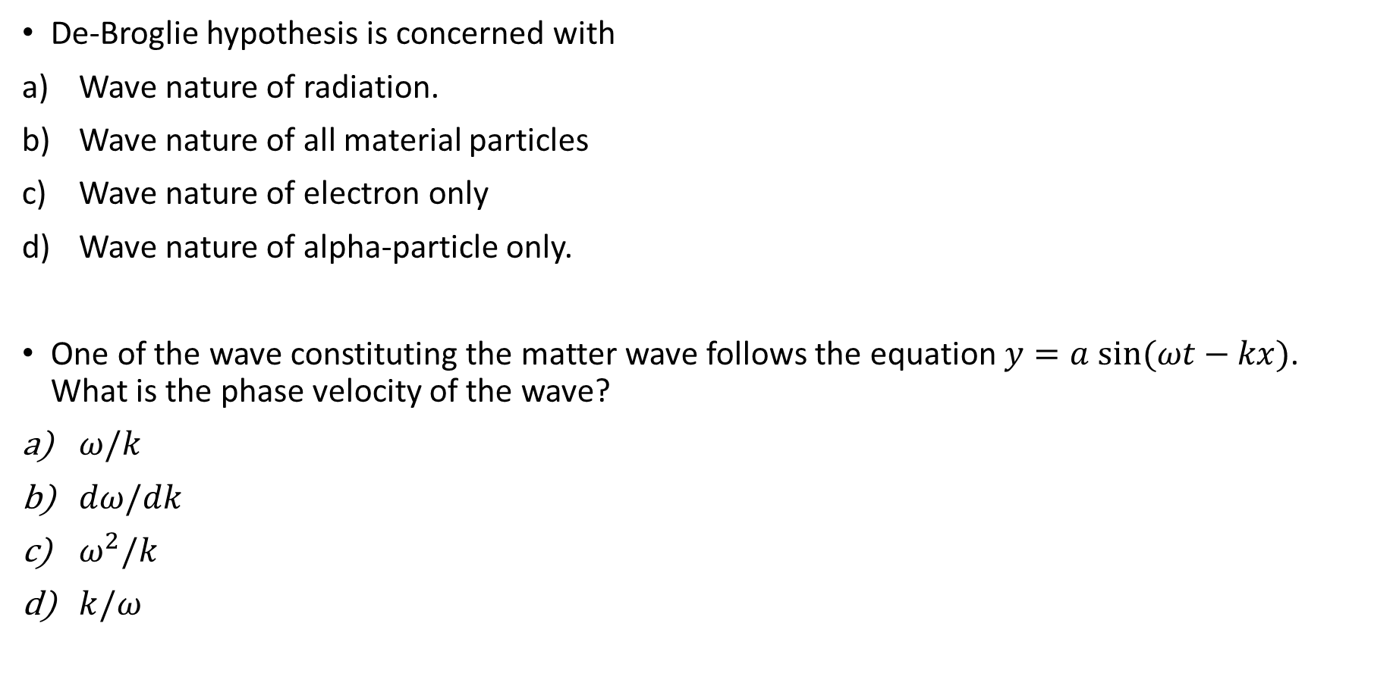
De-Broglie hypothesis is concerned with
Wave nature of radiation.
Wave nature of all material particles
Wave nature of electron only
Wave nature of alpha-particle only.
One of the wave constituting the matter wave follows the equation$y=a sin⁡(ωt−kx)$. What is the phase velocity of the wave?
$ω/k$
$dω/dk$
$ω^{2}/k$
$k/ω$

Slide 23

The relation between group velocity ($υ_{g}$) and phase velocity ($υ_{p}$) is given by
$υ_{g}=υ_{p}−λ\frac{dυ_{p}}{dλ}$
$υ_{g}=υ_{p}−\frac{1}{λ}\frac{dυ_{p}}{dλ}$
$υ_{g}=υ_{p}^{2}−λ\frac{dυ_{p}}{dλ}$
$υ_{g}={2υ}_{p}−λ\frac{dυ_{p}}{dλ}$

Slide 24
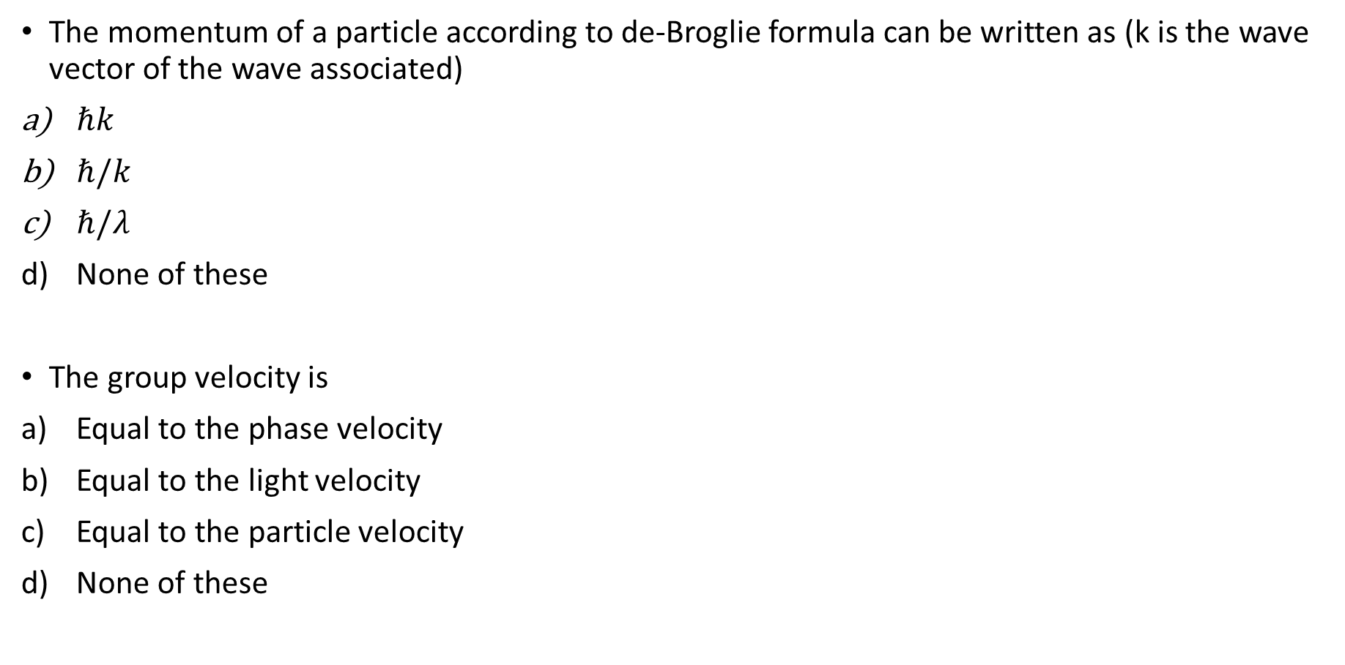
The momentum of a particle according to de-Broglie formula can be written as (k is the wave vector of the wave associated)
$ℏk$
$ℏ/k$
$ℏ/λ$
None of these
The group velocity is
Equal to the phase velocity
Equal to the light velocity
Equal to the particle velocity
None of these

Slide 25

The velocity of matter wave is
$>c$
$=c$
$<c$
$None of these$
If the kinetic energy of a particle is E, then the de-Broglie wavelength is expressed as
$λ=h/\sqrt{3mE}$
$λ=h/\sqrt{\frac{3}{2}mE}$
$λ=h/\sqrt{5mE}$
$λ=h/\sqrt{2mE}$

Slide 26
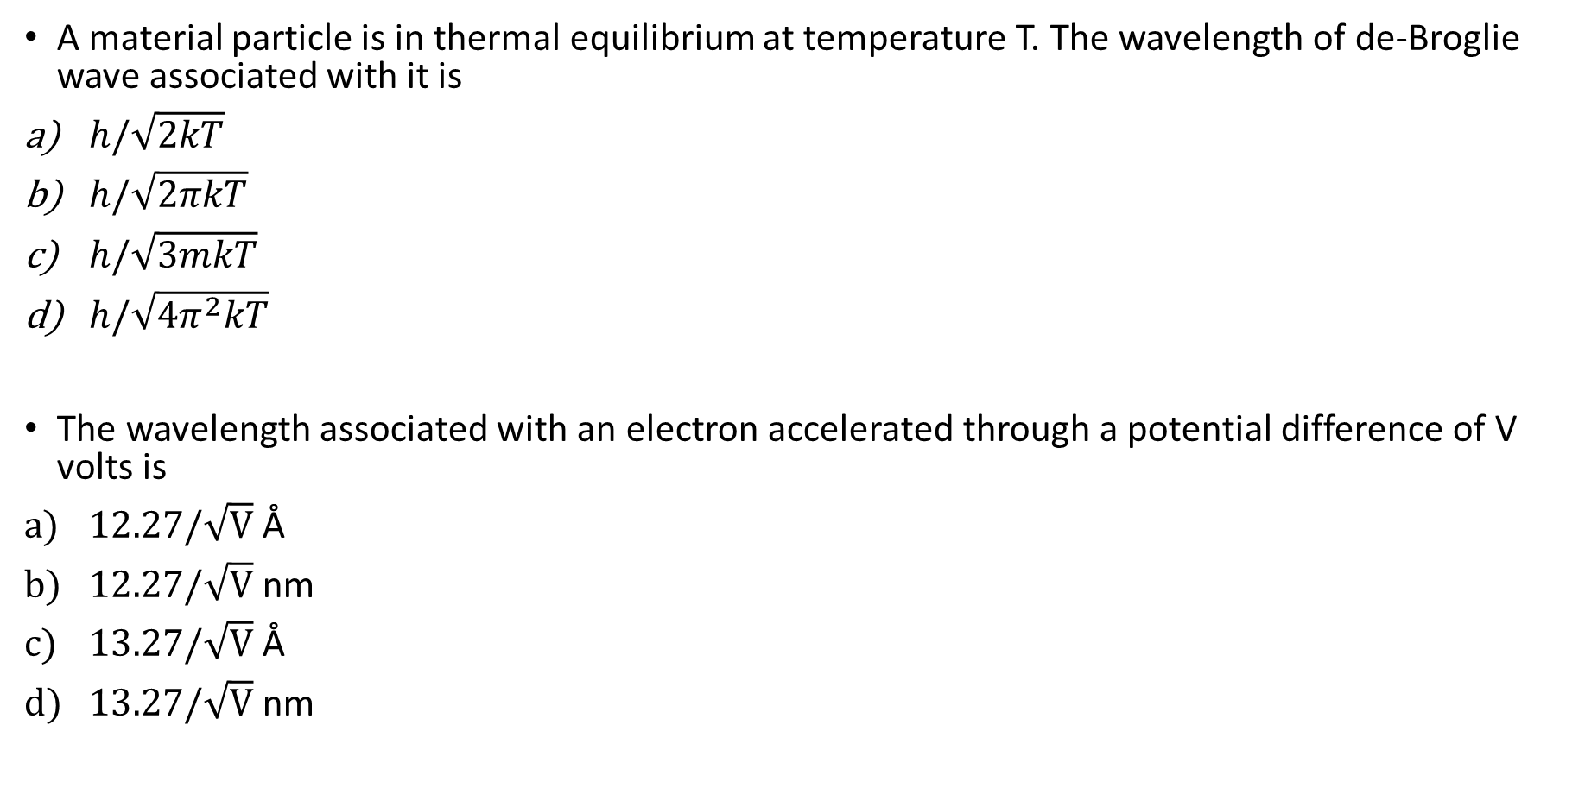
A material particle is in thermal equilibrium at temperature T. The wavelength of de-Broglie wave associated with it is
$h/\sqrt{2kT}$
$h/\sqrt{2πkT}$
$h/\sqrt{3mkT}$
$h/\sqrt{4π^{2}kT}$
The wavelength associated with an electron accelerated through a potential difference of V volts is
$12.27/\sqrt{V}$ Å
$12.27/\sqrt{V}$ nm
$13.27/\sqrt{V}$ Å
$13.27/\sqrt{V}$ nm

Slide 27
An electron is accelerated through a potential difference of 100 volts. The de-Broglie wavelength associated is
1.227 Å
1.227 nm
5 m
None of these

Slide 28
Heisenberg’s Uncertainty Principle
Precise determination of position and momentum simultaneously of a moving particle is not possible.
It has a fundamental limit.
The position of the narrow de Broglie wave can be measured precisely but wavelength (and consequently momentum) can not be measured precisely
The wavelength (and consequently momentum) of de Broglie wave can be measured precisely but position can not be measured precisely

Slide 29
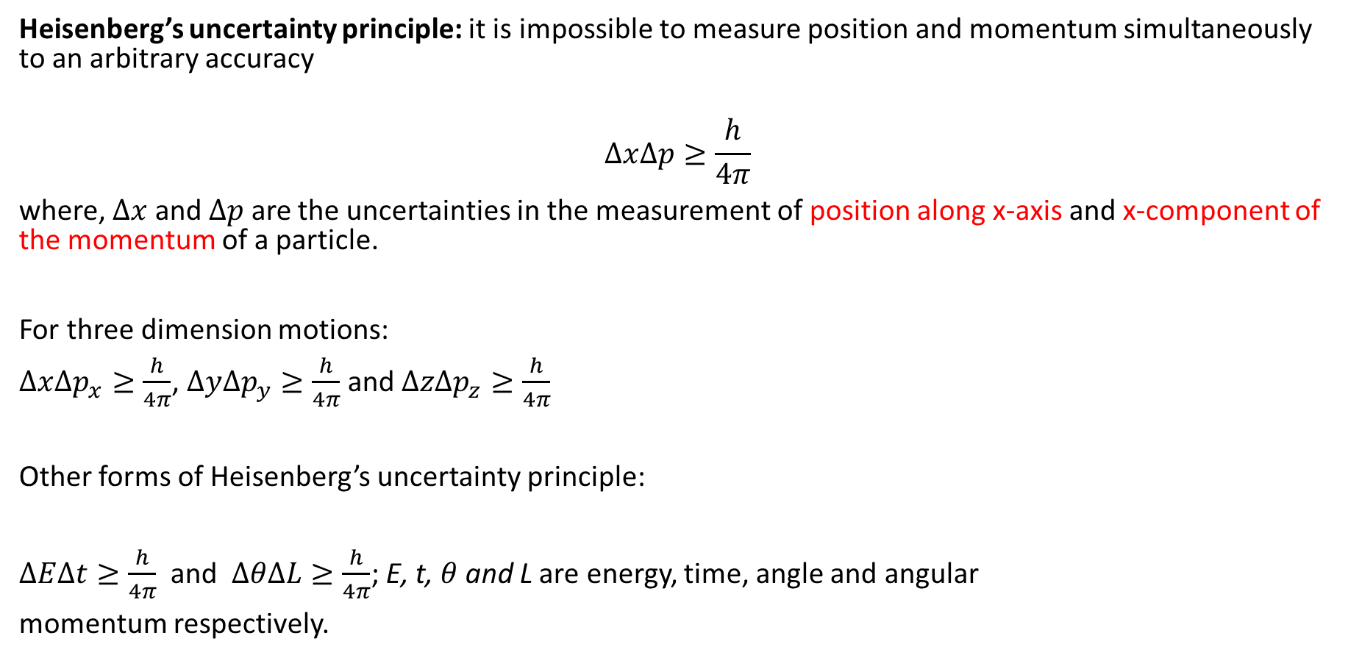
Heisenberg’s uncertainty principle: it is impossible to measure position and momentum simultaneously to an arbitrary accuracy
$$∆x∆p≥\frac{h}{4π}$$
where, $∆x$ and $∆p$ are the uncertainties in the measurement of position along x-axis and x-component of the momentum of a particle.
For three dimension motions:
$∆x∆p_{x}≥\frac{h}{4π}$, $∆y∆p_{y}≥\frac{h}{4π}$ and $∆z∆p_{z}≥\frac{h}{4π}$
Other forms of Heisenberg’s uncertainty principle:
$∆E∆t≥\frac{h}{4π}$ and $∆θ∆L≥\frac{h}{4π}$; E, t, $θ$ and L are energy, time, angle and angular
momentum respectively.

Slide 30

Practice problems
Find the correct relation regarding the Heisenberg’s uncertainty principle.
$ΔE×Δt≥\frac{h}{4π}$
$Δp×Δx≥\frac{h}{4π}$
$ΔL×Δθ≥\frac{h}{4π}$
All of them
What is the uncertainty associated with momentum, when position is measured with absolute accuracy
0
$∞$
h/2π
h/4π

Slide 31
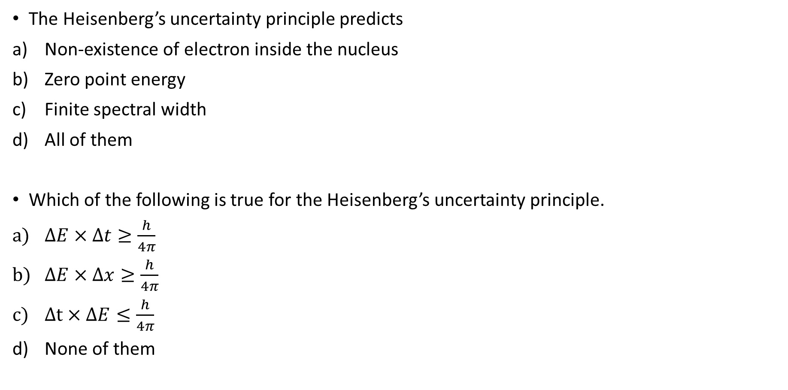
The Heisenberg’s uncertainty principle predicts
Non-existence of electron inside the nucleus
Zero point energy
Finite spectral width
All of them
Which of the following is true for the Heisenberg’s uncertainty principle.
$ΔE×Δt≥\frac{h}{4π}$
$ΔE×Δx≥\frac{h}{4π}$
$Δt×ΔE≤\frac{h}{4π}$
None of them

Slide 32
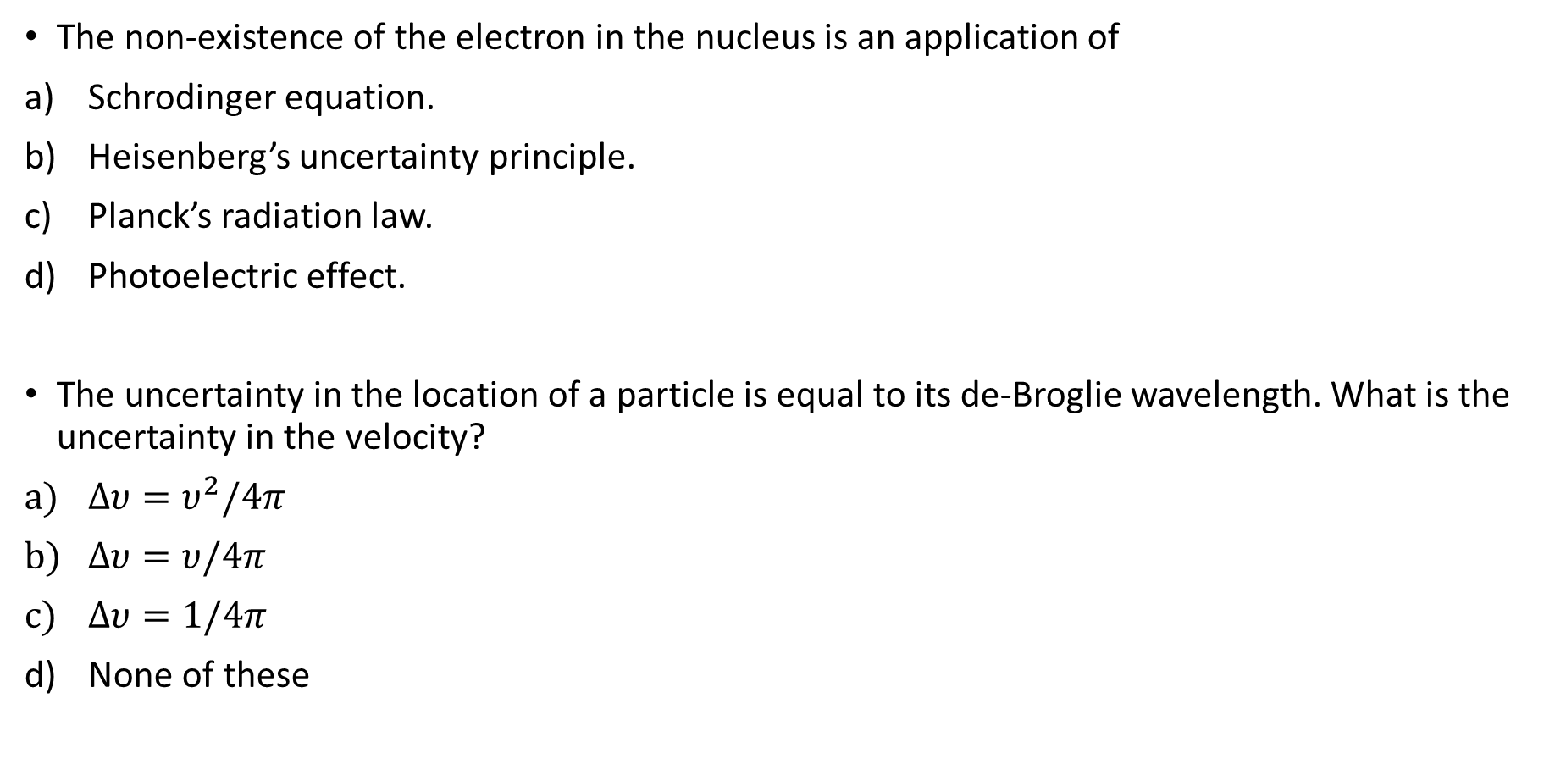
The non-existence of the electron in the nucleus is an application of
Schrodinger equation.
Heisenberg’s uncertainty principle.
Planck’s radiation law.
Photoelectric effect.
The uncertainty in the location of a particle is equal to its de-Broglie wavelength. What is the uncertainty in the velocity?
$Δυ=υ^{2}/4π$
$Δυ=υ/4π$
$Δυ=1/4π$
None of these

Slide 33
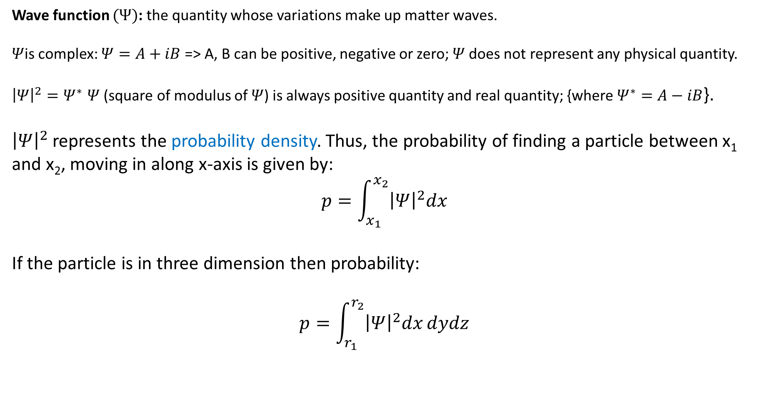
Properties of wave function
Wave function $(Ψ)$: the quantity whose variations make up matter waves.
$Ψ$is complex: $Ψ=A+iB$ => A, B can be positive, negative or zero; $Ψ$does not represent any physical quantity.
${\left|Ψ\right|}^{2}{=Ψ}^{∗}Ψ$ (square of modulus of $Ψ$) is always positive quantity and real quantity; {where$Ψ^{∗}=A−iB$}.
${\left|Ψ\right|}^{2}$ represents the probability density. Thus, the probability of finding a particle between x₁ and x₂, moving in along x-axis is given by:
$$p=\int_{x_{1}}^{x_{2}}{{\left|Ψ\right|}^{2}dx}$$
If the particle is in three dimension then probability:
$$p=\int_{r_{1}}^{r_{2}}{{\left|Ψ\right|}^{2}dx}dydz$$

Slide 34
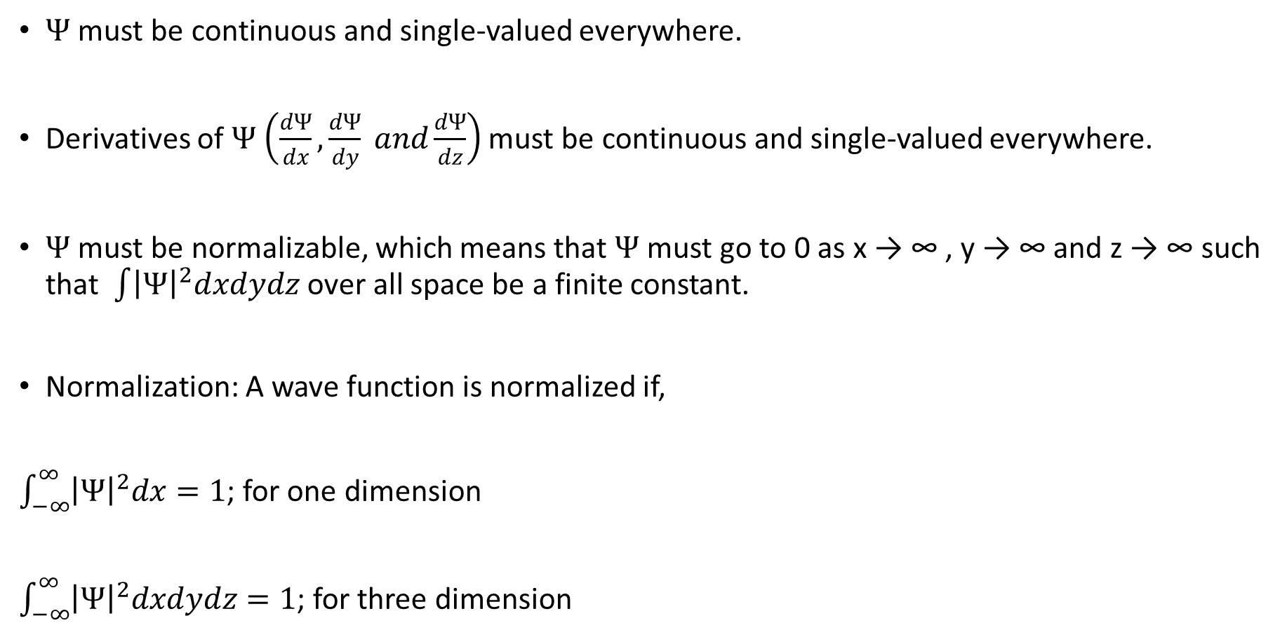
Properties of a well behaved wave function
$Ψ$ must be continuous and single-valued everywhere.
Derivatives of $Ψ\left(\frac{dΨ}{dx},\frac{dΨ}{dy} and\frac{dΨ}{dz}\right)$ must be continuous and single-valued everywhere.
$Ψ$ must be normalizable, which means that $Ψ$ must go to 0 as x → ∞, y → ∞ and z → ∞ such that $\int{{\left|Ψ\right|}^{2}dxdydz}$ over all space be a finite constant.
Normalization: A wave function is normalized if,
$\int_{−∞}^{∞}{{\left|Ψ\right|}^{2}dx}=1$; for one dimension
$\int_{−∞}^{∞}{{\left|Ψ\right|}^{2}dxdydz}=1$; for three dimension

Slide 35
Examples of wave function
Well-behaved wave functions
Not well-behaved wave functions

Slide 36
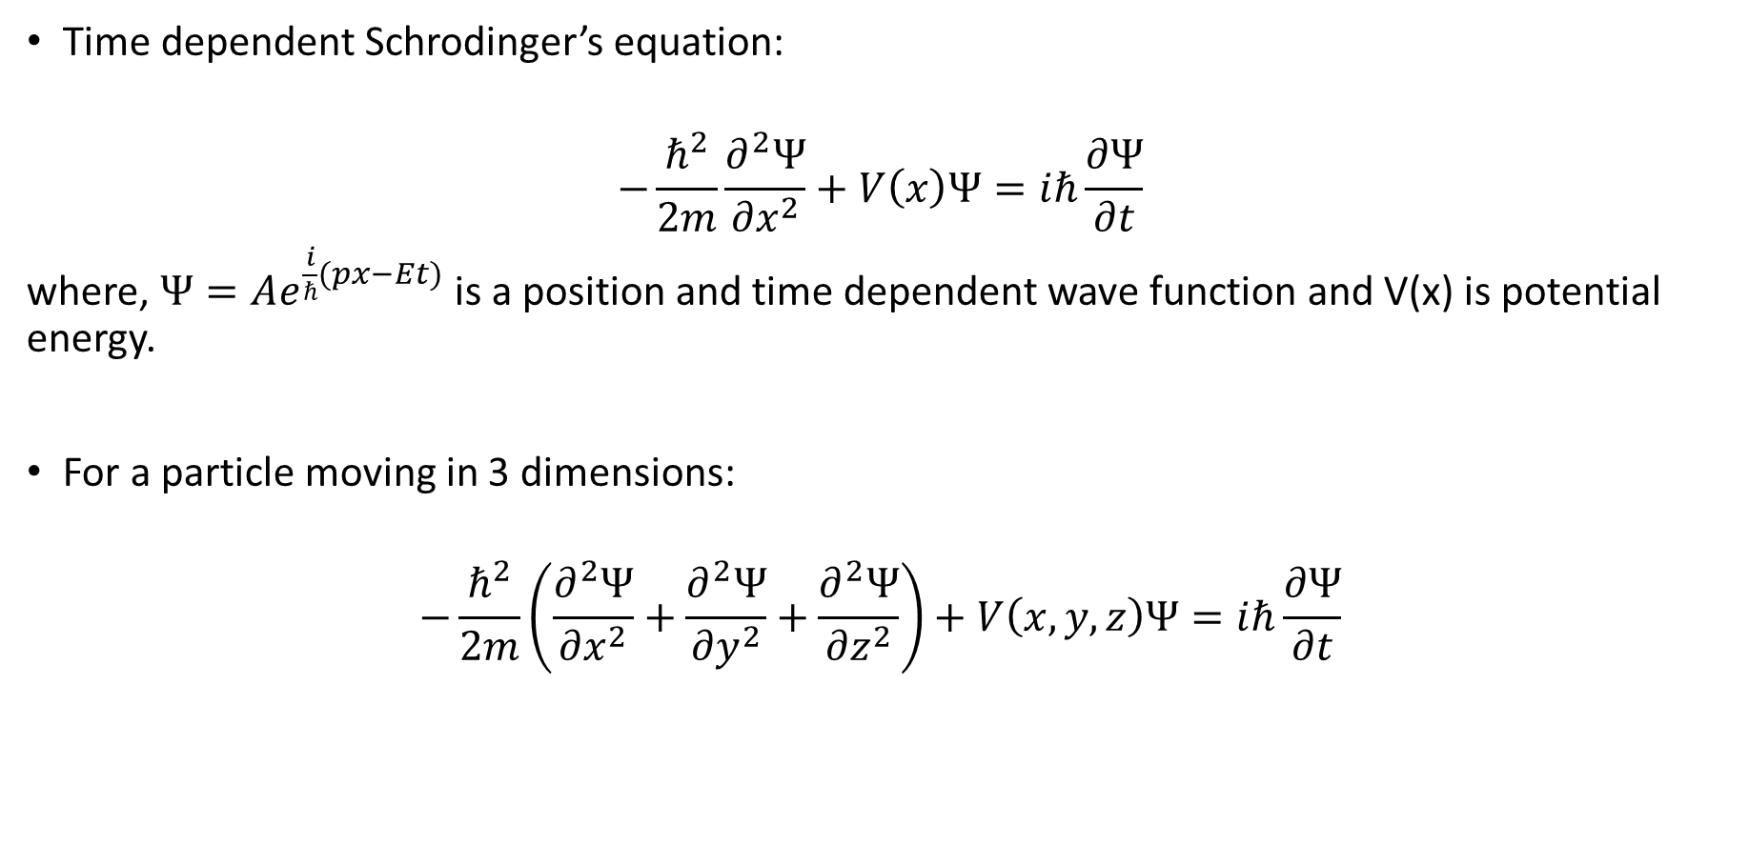
Schrodinger’s equation
Time dependent Schrodinger’s equation:
$$−\frac{ℏ^{2}}{2m}\frac{∂^{2}Ψ}{{∂x}^{2}}+V\left(x\right)Ψ=iℏ\frac{∂Ψ}{∂t}$$
where, $Ψ=Ae^{\frac{i}{ℏ}(px−Et)}$ is a position and time dependent wave function and V(x) is potential energy.
For a particle moving in 3 dimensions:
$$−\frac{ℏ^{2}}{2m}\left(\frac{∂^{2}Ψ}{{∂x}^{2}}+\frac{∂^{2}Ψ}{{∂y}^{2}}+\frac{∂^{2}Ψ}{{∂z}^{2}}\right)+V\left(x,y,z\right)Ψ=iℏ\frac{∂Ψ}{∂t}$$

Slide 37
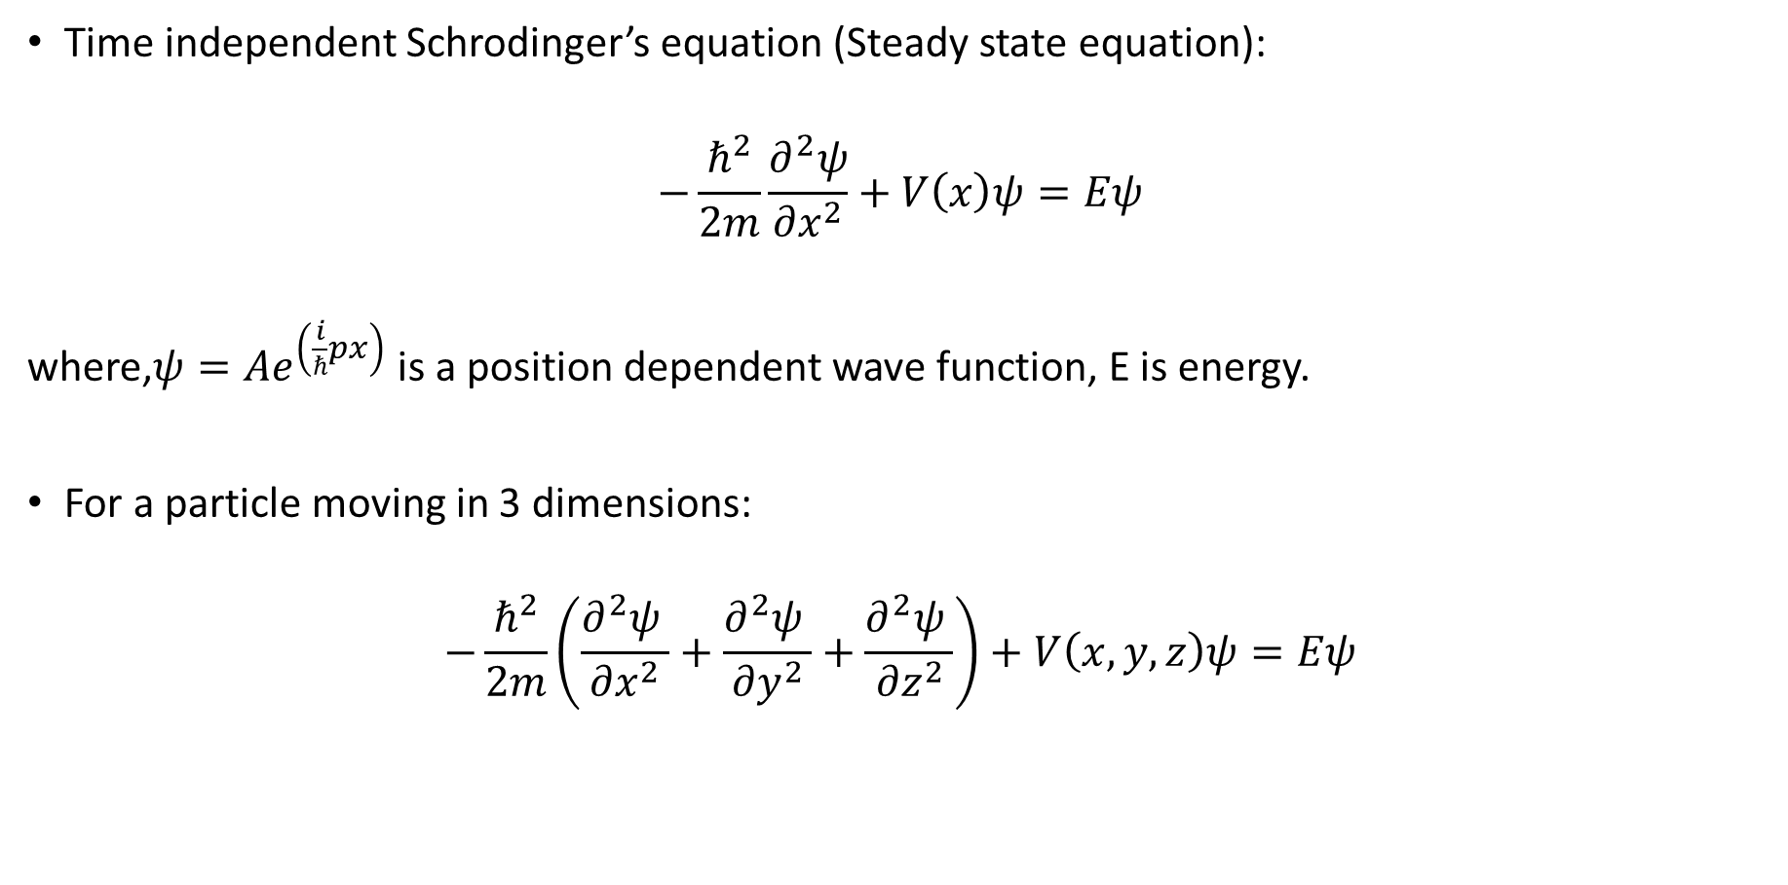
Time independent Schrodinger’s equation (Steady state equation):
$$−\frac{ℏ^{2}}{2m}\frac{∂^{2}ψ}{{∂x}^{2}}+V\left(x\right)ψ=Eψ$$
where,$ψ=Ae^{\left(\frac{i}{ℏ}px\right)}$ is a position dependent wave function, E is energy.
For a particle moving in 3 dimensions:
$$−\frac{ℏ^{2}}{2m}\left(\frac{∂^{2}ψ }{{∂x}^{2}}+\frac{∂^{2}ψ }{{∂y}^{2}}+\frac{∂^{2}ψ }{{∂z}^{2}}\right)+V\left(x,y,z\right)ψ=Eψ$$

Slide 38
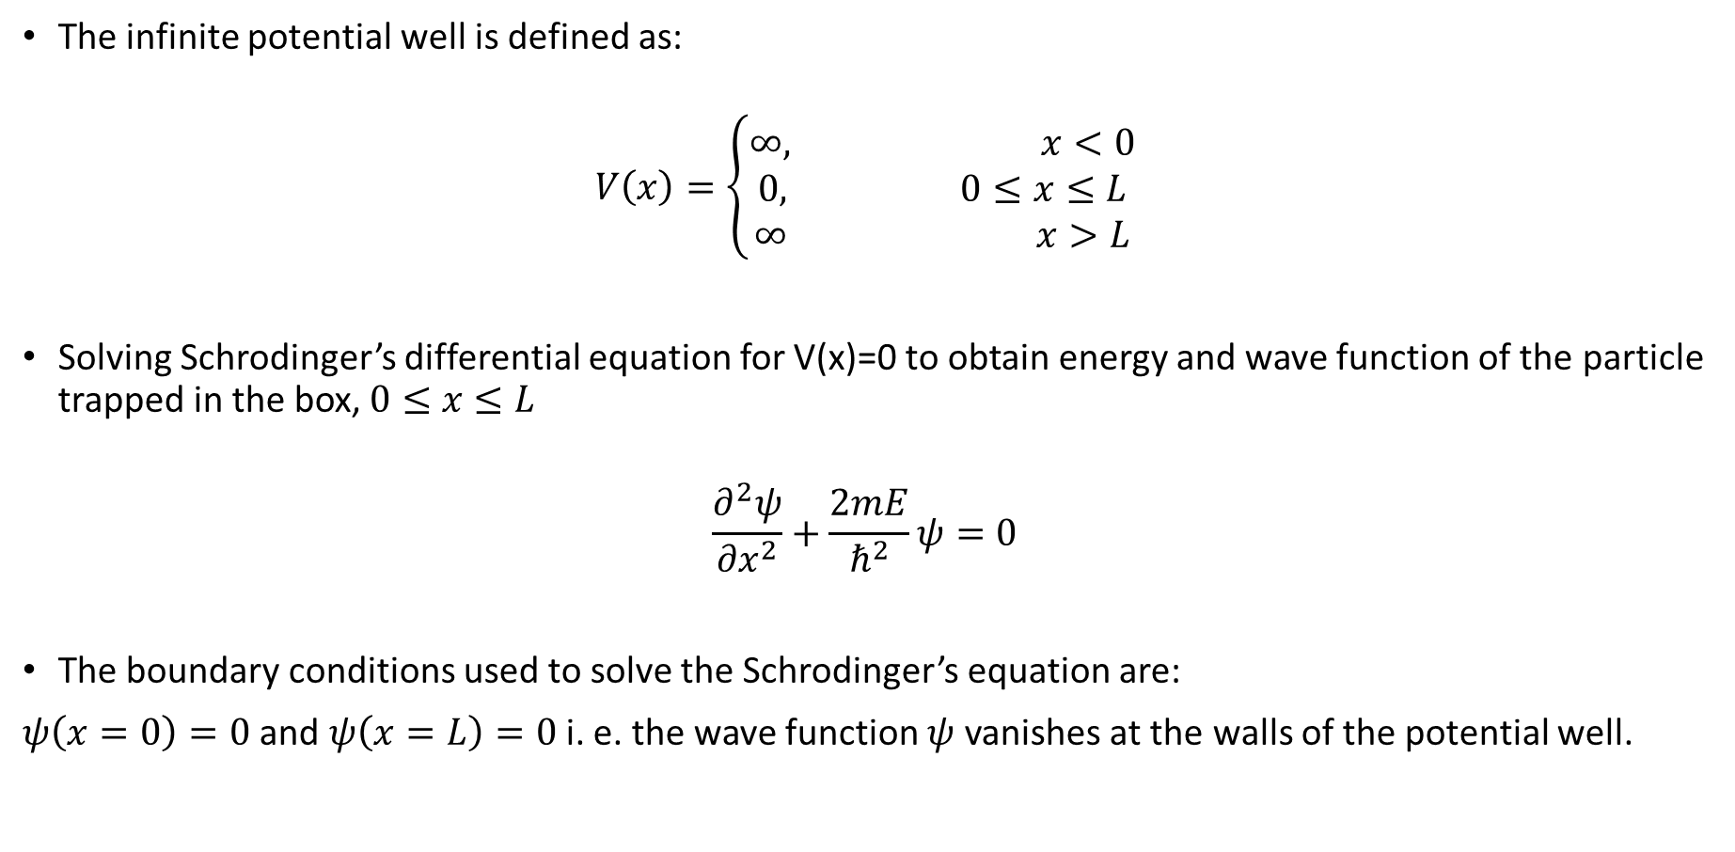
Particle in an infinite potential well (box)
The infinite potential well is defined as:
$$V\left(x\right)=\left\{\begin{aligned}∞, x<0 \\ 0, 0≤x≤L \\ ∞ x>L\end{aligned}\right.$$
Solving Schrodinger’s differential equation for V(x)=0 to obtain energy and wave function of the particle trapped in the box, $0≤x≤L$
$$\frac{∂^{2}ψ}{{∂x}^{2}}+\frac{2mE}{ℏ^{2}}ψ=0$$
The boundary conditions used to solve the Schrodinger’s equation are:
$ψ\left(x=0\right)=0$ and $ψ\left(x=L\right)=0$i. e. the wave function $ψ$ vanishes at the walls of the potential well.
Infinite potential well

Slide 39

The wave function of the particle is for nth state is given by:
$${ψ }_{n}=\sqrt{\frac{2}{L}}sin\left(\frac{nπx}{L}\right)$$
The energy of the particle is for nth state is given by:
$$E_{n}=\frac{n^{2}π^{2}ℏ^{2}}{2mL^{2}}$$
The momentum of the particle is for nth state is given by:
$$p_{n}=\frac{nπℏ}{L}$$
where n, m, L are quantum number, mass of the particle, length of the box.
The value of n is 1, 2, 3,…….

Slide 40
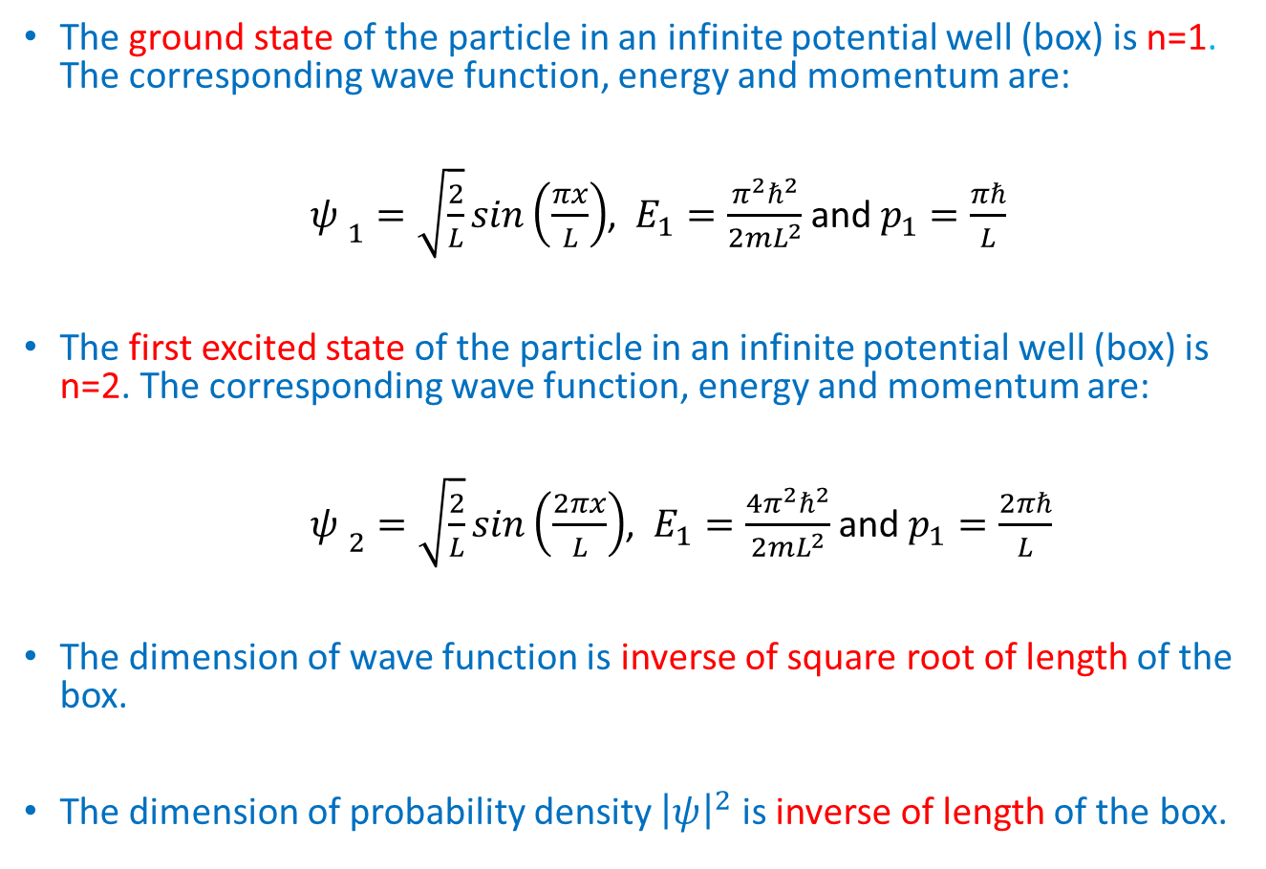
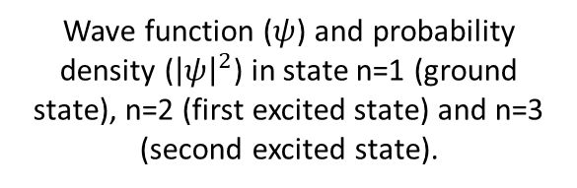
Discussion
Theground state of the particle in an infinite potential well (box) is n=1. The corresponding wave function, energy and momentum are:
${ψ }_{1}=\sqrt{\frac{2}{L}}sin\left(\frac{πx}{L}\right)$, $E_{1}=\frac{π^{2}ℏ^{2}}{2mL^{2}}$ and $p_{1}=\frac{πℏ}{L}$
Thefirst excited state of the particle in an infinite potential well (box) isn=2. The corresponding wave function, energy and momentum are:
${ψ }_{2}=\sqrt{\frac{2}{L}}sin\left(\frac{2πx}{L}\right)$, $E_{1}=\frac{{4π}^{2}ℏ^{2}}{2mL^{2}}$ and $p_{1}=\frac{2πℏ}{L}$
The dimension of wave function isinverse of square root of length of the box.
The dimension of probability density ${\left|ψ\right|}^{2}$ is inverse of length of the box.
Wave function ($ψ$) and probability density (${\left|ψ\right|}^{2}$) in state n=1 (ground state), n=2 (first excited state) and n=3 (second excited state).

Slide 41
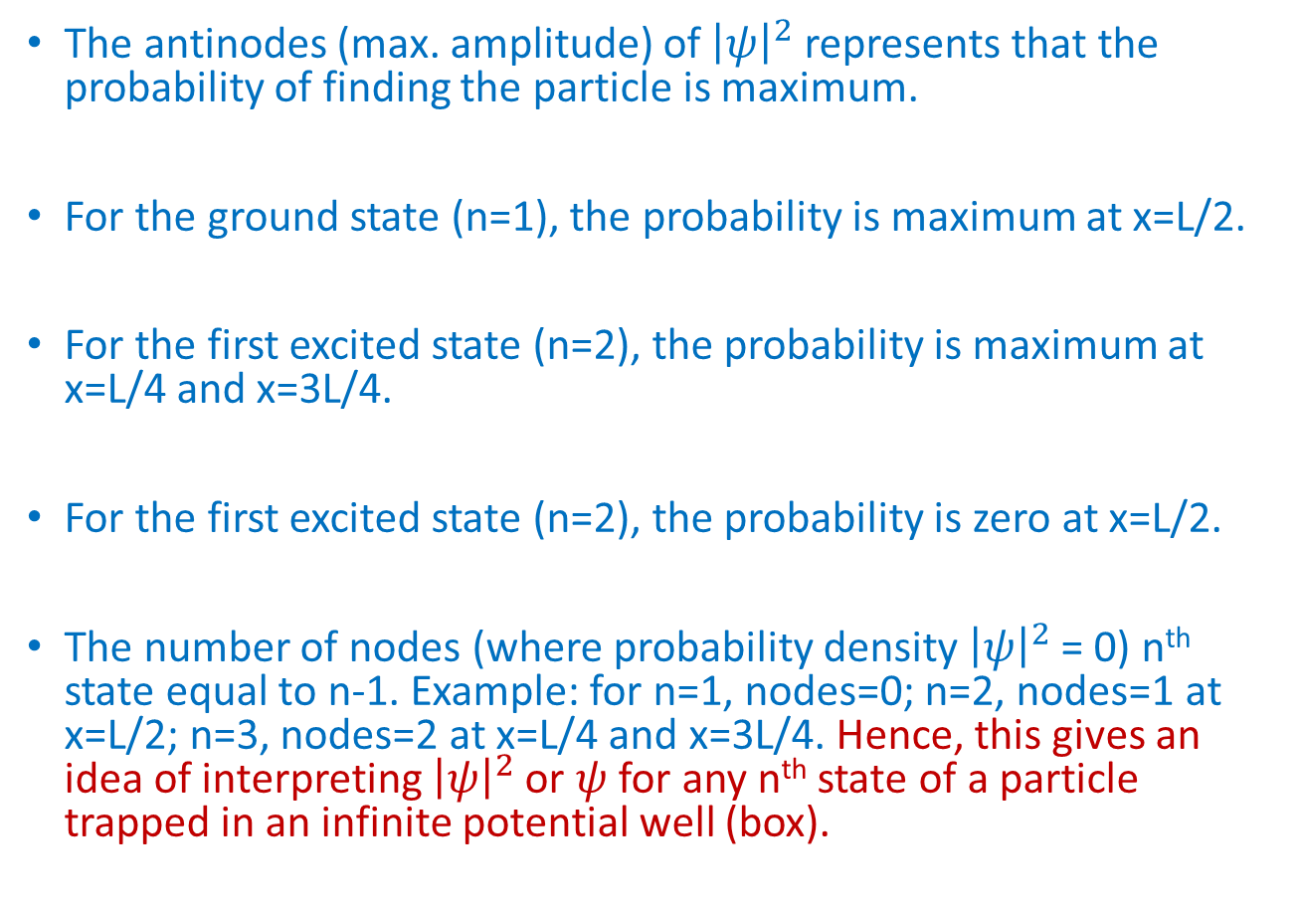
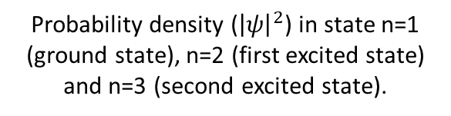
Discussion
The antinodes (max. amplitude) of ${\left|ψ\right|}^{2}$ represents that the probability of finding the particle is maximum.
For the ground state (n=1), the probability is maximum at x=L/2.
For the first excited state (n=2), the probability is maximum at x=L/4 and x=3L/4.
For the first excited state (n=2), the probability is zero at x=L/2.
The number of nodes (where probability density ${\left|ψ\right|}^{2}$ = 0) n^{th} state equal to n-1. Example: for n=1, nodes=0; n=2, nodes=1 at x=L/2; n=3, nodes=2 at x=L/4 and x=3L/4. Hence, this gives an idea of interpreting ${\left|ψ\right|}^{2}$ or $ψ$ for any n^{th} state of a particle trapped in an infinite potential well (box).
Probability density (${\left|ψ\right|}^{2}$) in state n=1 (ground state), n=2 (first excited state) and n=3 (second excited state).

Slide 42
Bibliography
Text Books:
ENGINEERING PHYSICS, Hitendra K Malik And A K Singh, Mcgraw Hill Education, First Edition, (2009).
Further readings:
QUANTUM MECHANICS: CONCEPTS AND APPLICATIONS, Nouredine Zettili, Second Edition, John Wiley & Sons, Ltd., (2009).
CONCEPTS OF MODERN PHYSICS, Arthur Beiser, McGraw-Hill Higher Education, Sixth Edition, (2003)*.
*most of the figures have taken from this book.

